Slide 1
Updating gene expression analysis to the transcript level using RNA-seq
A comprehensive solutions and tools for RNA-seq data
Runxuan Zhang
Information and Computational Sciences, The James Hutton Institute
CyVerse UK RNASeq Workshop, Dec 12th , 2018

Slide 2
Outline
Promises and challenges and of RNA-seq data
New resources, pipelines and methods for improved RNA-seq analysis
Summary

Slide 3
Promises of RNA-seq data
RNA-seq invented shortly after Next Generation Sequencing (NGS) ~ 13 years ago in 2005.
More complete transcriptome
transcript level quantification, with improve gene level quantification
Allows study of another layer of regulation: Alternative splicing

Slide 4
Challenges of RNA-seq analysis
Gene level and transcript level quantification
Differential Expression
Reads counts ~ Negative Binomial Distributions
Alternative splicing analysis
Transcript (alternative splicing) annotations incomplete or inaccurate
Gene/transcript quantifications
Reads

Slide 5


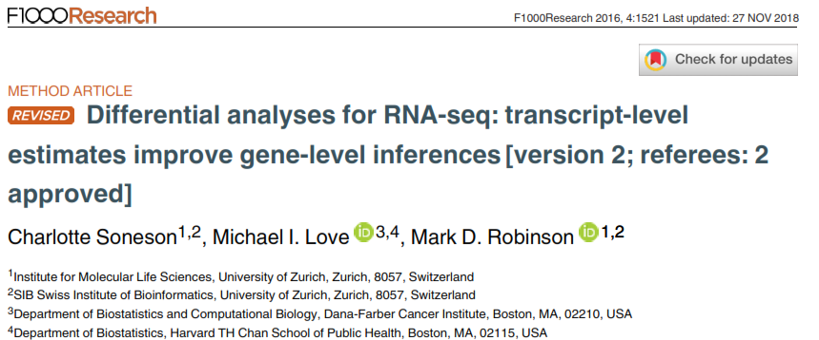
Gene level inference is more accurate using transcript level estimates

Slide 6



Accurate transcript level estimates depends on the reference
New alignment free transcript quantification tools developed -Sailfish, Salmon, kallisto…
Fast ( > 20-50 times faster)
Saves time and data storage
Accurate
Requires a transcript reference
Reference
Experiment

Slide 7

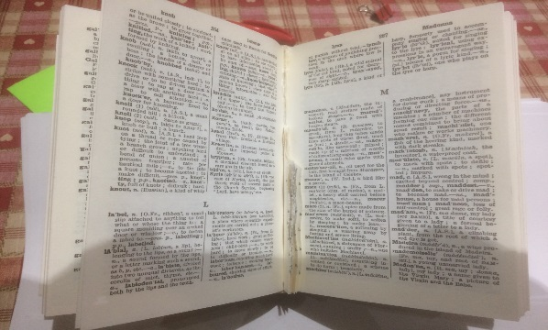

Accurate transcript level estimates depends on the reference
RTDs in Arabidopsis!
Existing transcript reference is typically incomplete or poor quality, particularly for plant species
Mapping to genome reference and assembled transcripts using Cufflinks, etc - main stream analysis methods for RNA-seq
Slow
Transcript assembly: 50%-80% mis-assembled and 50%-80% missing
TAIR10
Araport11
Machination, n, something invented
or contrived
Machination, n, something invented
or contrived
Maction, n, something invented
or contrived
Machinan, n, something invented
or contrived
chination, n, something invented
or contrived
Mach, n, something invented
or contrived
Mon, n, something invented
or contrived
Redundancy
False splice junctions
Transcript fragments

Slide 8
Outline
Promises and challenges and of RNA-seq data
New resources, pipelines and methods for improved RNA-seq analysis
Summary

Slide 9
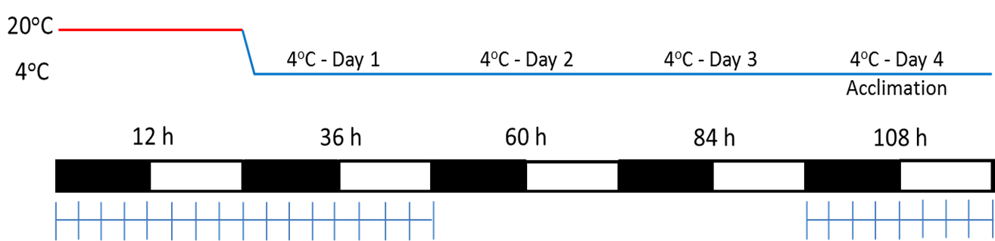
RNA-seq time-course of cold response in Arabidopsis
T1 T2 T3 T4 T5 T6 T7 T8 T9
T10 T12 T14 T16
T18 T20 T22 T24 T26
T11 T13 T15 T17
T19 T21 T23 T25
“Transition”
“Acclimated”
Cold Acclimation
Harvested at 3 h intervals
26 time points/3 biological
Total >4.7 billion pair of reads
John Brown and Hugh Nimmo (Glasgow)

Slide 10
RNA-seq time-course of cold response in Arabidopsis
T1 T2 T3 T4 T5 T6 T7 T8 T9
T10 T12 T14 T16
T18 T20 T22 T24 T26
T11 T13 T15 T17
T19 T21 T23 T25
“Transition”
“Acclimated”
Cold Acclimation
Challenges:
Accurate measure of gene expression AND alternative splicing
Time-series RNA-seq
Decided to use Sailfish/Salmon
John Brown and Hugh Nimmo (Glasgow)

Slide 11
Improving the accuracy of RNA-seq
–Reference Transcript Dataset (RTD)
Salmon
Accurate transcript quantification
Optimise
assembly/
merge
Quality
control
filters
Solve
Specific
issues
TAIR10
/Marquez, et al
Release of
Araport11
AtRTD2
2015
2017
2014
Generated
HR RT-PCR
AS data
AtRTD1
Assembled
>9.5 billion
paired-end
reads
Incorporate
Araport11
AtRTD2-QUASI
Analysis of
RNA-seq data
2015

Slide 12
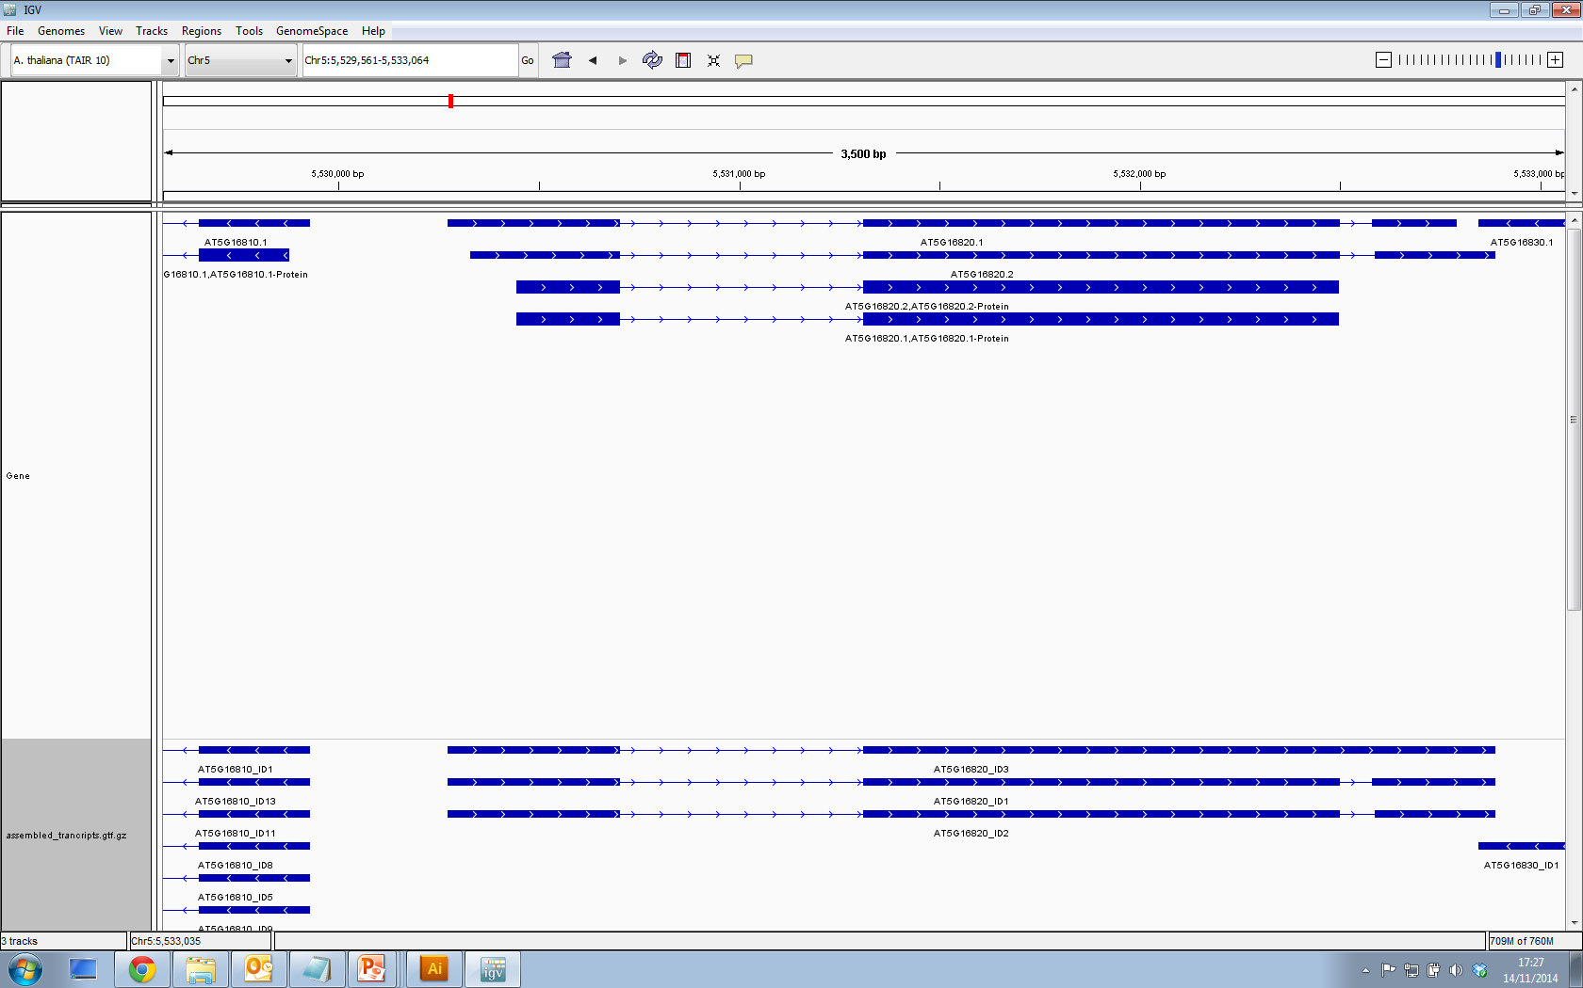
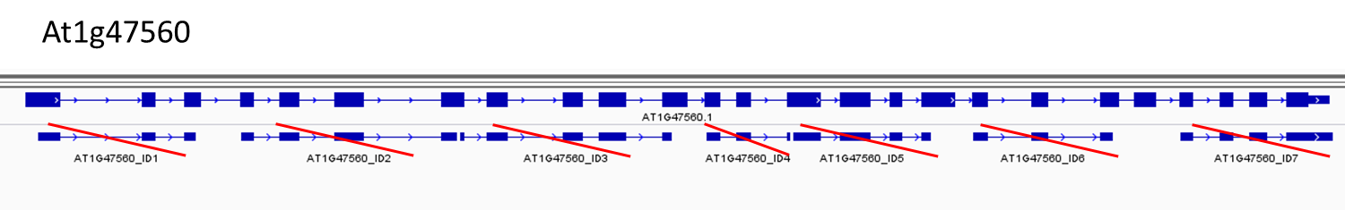
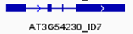
Improving the accuracy of RNA-seq
–Reference Transcript Dataset (RTD)
Missing Transcripts
Salmon
Accurate transcript quantification
Optimise
assembly/
merge
Quality
control
filters
Solve
Specific
issues
TAIR10
/Marquez, et al
Release of
Araport11
AtRTD2
2015
Redundancy
2017
2014
Fragments
Generated
HR RT-PCR
AS data
AtRTD1
Assembled
>9.5 billion
paired-end
reads
Incorporate
Araport11
AtRTD2-QUASI
Analysis of
RNA-seq data
2015

Slide 13
Improving the accuracy of RNA-seq
–Reference Transcript Dataset (RTD)
Mis-assembled
transcripts
Salmon
Accurate transcript quantification
Optimise
assembly/
merge
Quality
control
filters
Solve
Specific
issues
TAIR10
/Marquez, et al
Release of
Araport11
AtRTD2
2015
2017
2014
Generated
HR RT-PCR
AS data
AtRTD1
Assembled
>9.5 billion
paired-end
reads
Incorporate
Araport11
AtRTD2-QUASI
Analysis of
RNA-seq data
2015
Missing transcripts

Slide 14
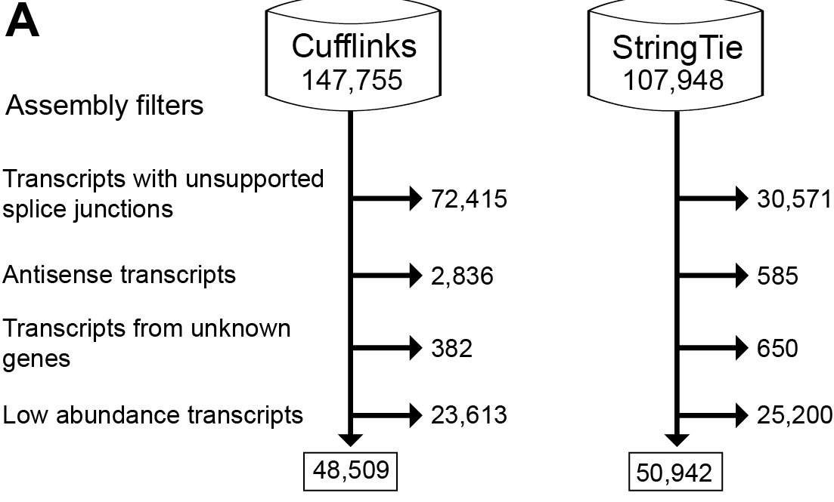
Improving the accuracy of RNA-seq
–Reference Transcript Dataset (RTD)
Mis-assembly/splice junctions
Salmon
Accurate transcript quantification
Optimise
assembly/
merge
Quality
control
filters
Solve
Specific
issues
TAIR10
/Marquez, et al
Release of
Araport11
AtRTD2
2015
2017
2014
Generated
HR RT-PCR
AS data
AtRTD1
Assembled
>9.5 billion
paired-end
reads
Incorporate
Araport11
AtRTD2-QUASI
Analysis of
RNA-seq data
2015

Slide 15
Improving the accuracy of RNA-seq
–Reference Transcript Dataset (RTD)
Salmon
Accurate transcript quantification
Optimise
assembly/
merge
Quality
control
filters
Solve
Specific
issues
TAIR10
/Marquez, et al
Release of
Araport11
AtRTD2
2015
2017
2014
Generated
HR RT-PCR
AS data
AtRTD1
Assembled
>9.5 billion
paired-end
reads
Incorporate
Araport11
AtRTD2-QUASI
Analysis of
RNA-seq data
2015

Slide 16
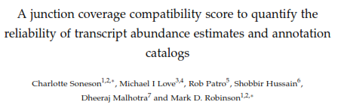
Improving the accuracy of RNA-seq
–Reference Transcript Dataset (RTD)
Salmon
Accurate transcript quantification
Optimise
assembly/
merge
Quality
control
filters
Solve
Specific
issues
TAIR10
/Marquez, et al
Release of
Araport11
AtRTD2
2015
2017
Quantification affected by:
Variation in UTR lengths
2014
Generated
HR RT-PCR
AS data
AtRTD1
Assembled
>9.5 billion
paired-end
reads
Incorporate
Araport11
AtRTD2-QUASI
Analysis of
RNA-seq data
2015
Quantification strongly affected by mis-annotation at 3’ UTR in human

Slide 17
AtRTD2-QUASI Quantification of Alternatively Spliced Isoforms
Version of RTD2 designed specifically for quantifying transcript isoforms
Pad transcripts with genomic sequence
Notes:
Tried various things but “padding” to the length of the longest transcript with genome sequences making all transcripts the same legnt solved the issue.

Slide 18
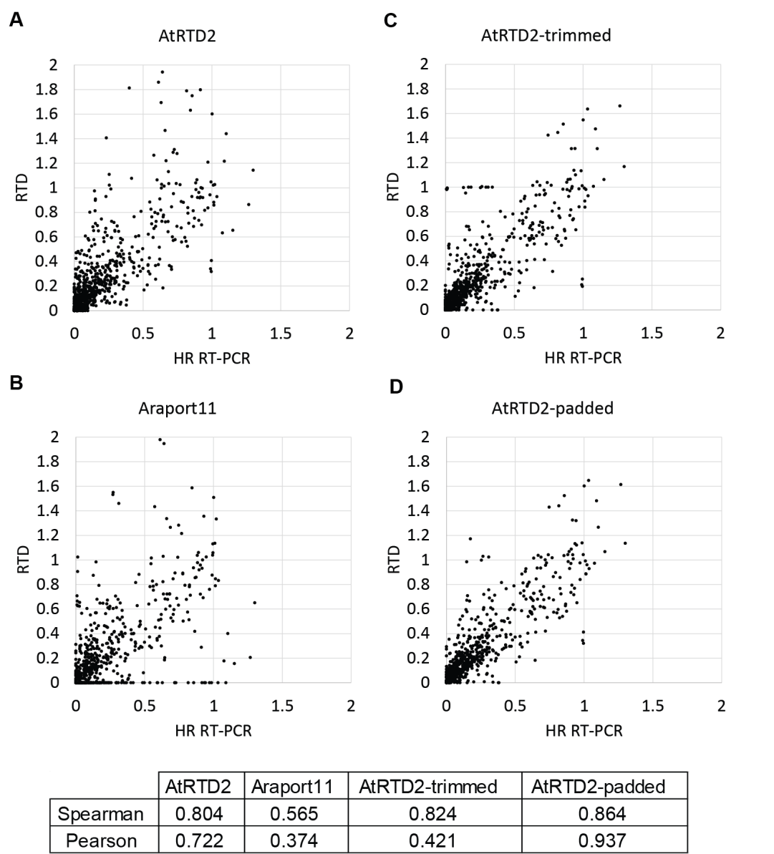
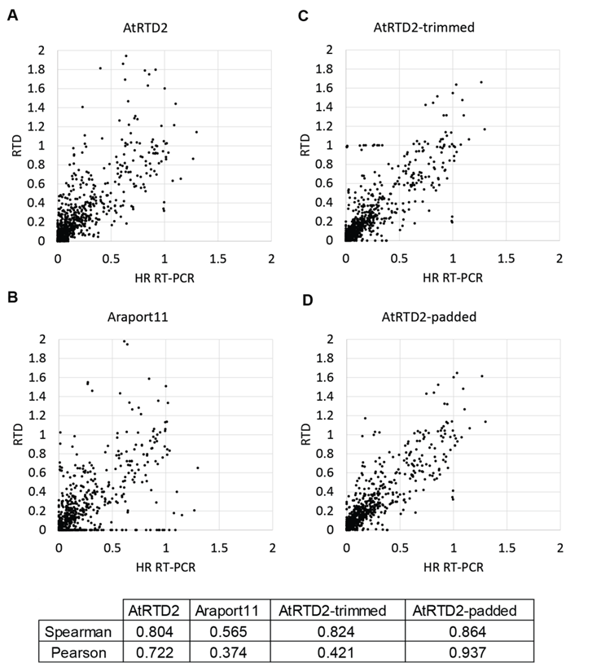
Improving AS quantification with atRTD2-QUASI (padded)
762 data points (3 bio reps x 2 time points x 127 AS events) from 62 genes.
AtRTD2-QUASI

Slide 19

Reference Transcript Dataset (RTD) for other species?
Salmon
Accurate transcript quantification
Optimise
assembly/
merge
Quality
control
filters
Solve
Specific
issues
TAIR10
/Marquez, et al
Release of
Araport11
AtRTD2
2015
2017
2014
Generated
HR RT-PCR
AS data
AtRTD1
Assembled
>9.5 billion
paired-end
reads
Incorporate
Araport11
AtRTD2-QUASI
DE Analysis of
RNA-seq data
2015
Zhang et al. (2017)
AtRTD2/AtRTD2-QAUSI fasta and gff download: https://ics.hutton.ac.uk/atRTD/

Slide 20

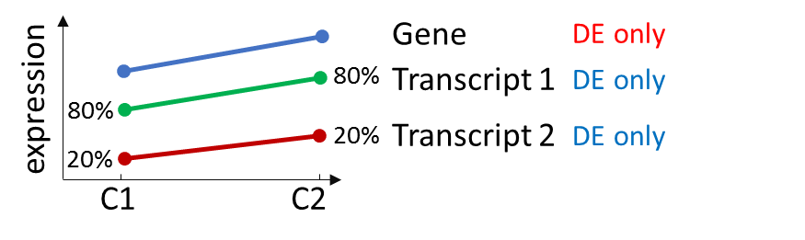
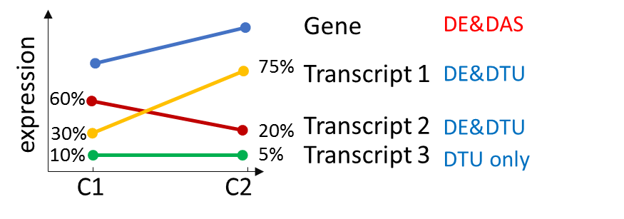
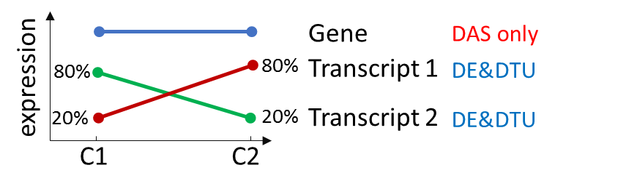
Cutting edge differential expression analysis tool 3D RNA-seq for DE/DAS/DTU analysis
DE: abundance change between conditions
DAS gene: changes of this gene are different to its transcripts
DTU transcript: changes of this transcript are different to all the other transcripts

Slide 21
Cutting edge pre-processing pipeline
Remove low
expressed
transcripts/
genes
Estimate
batch effects
Data
normalisation
Generate
read counts
Transcript
quantification
Visualise
data quality
DE/DAS analysis
pipeline
Salmon
Tximport R
package
Mean
variance
trend
RUVSeq R package
TMM
PCA plot/
FactoMineR R package

Slide 22
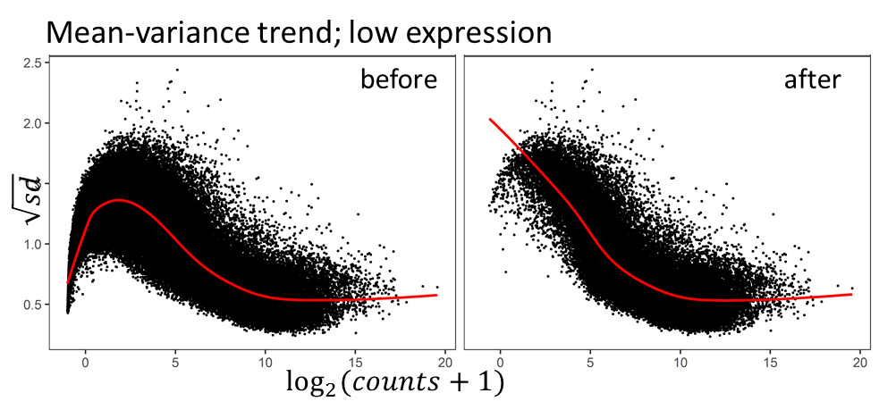
Cutting edge pre-processing pipeline for DE and DAS analysis
Remove low
expressed
transcripts/
genes
Remove low expressed transcripts/genes to improve model
Generate
read counts
Estimate
batch effects
Data
normalisation
Transcript
quantification
Visualise
data quality
DE/DAS analysis
pipeline
Salmon
Tximport R
package
Mean
variance
trend
RUVSeq R package
TMM
PCA plot/
FactoMineR R package

Slide 23
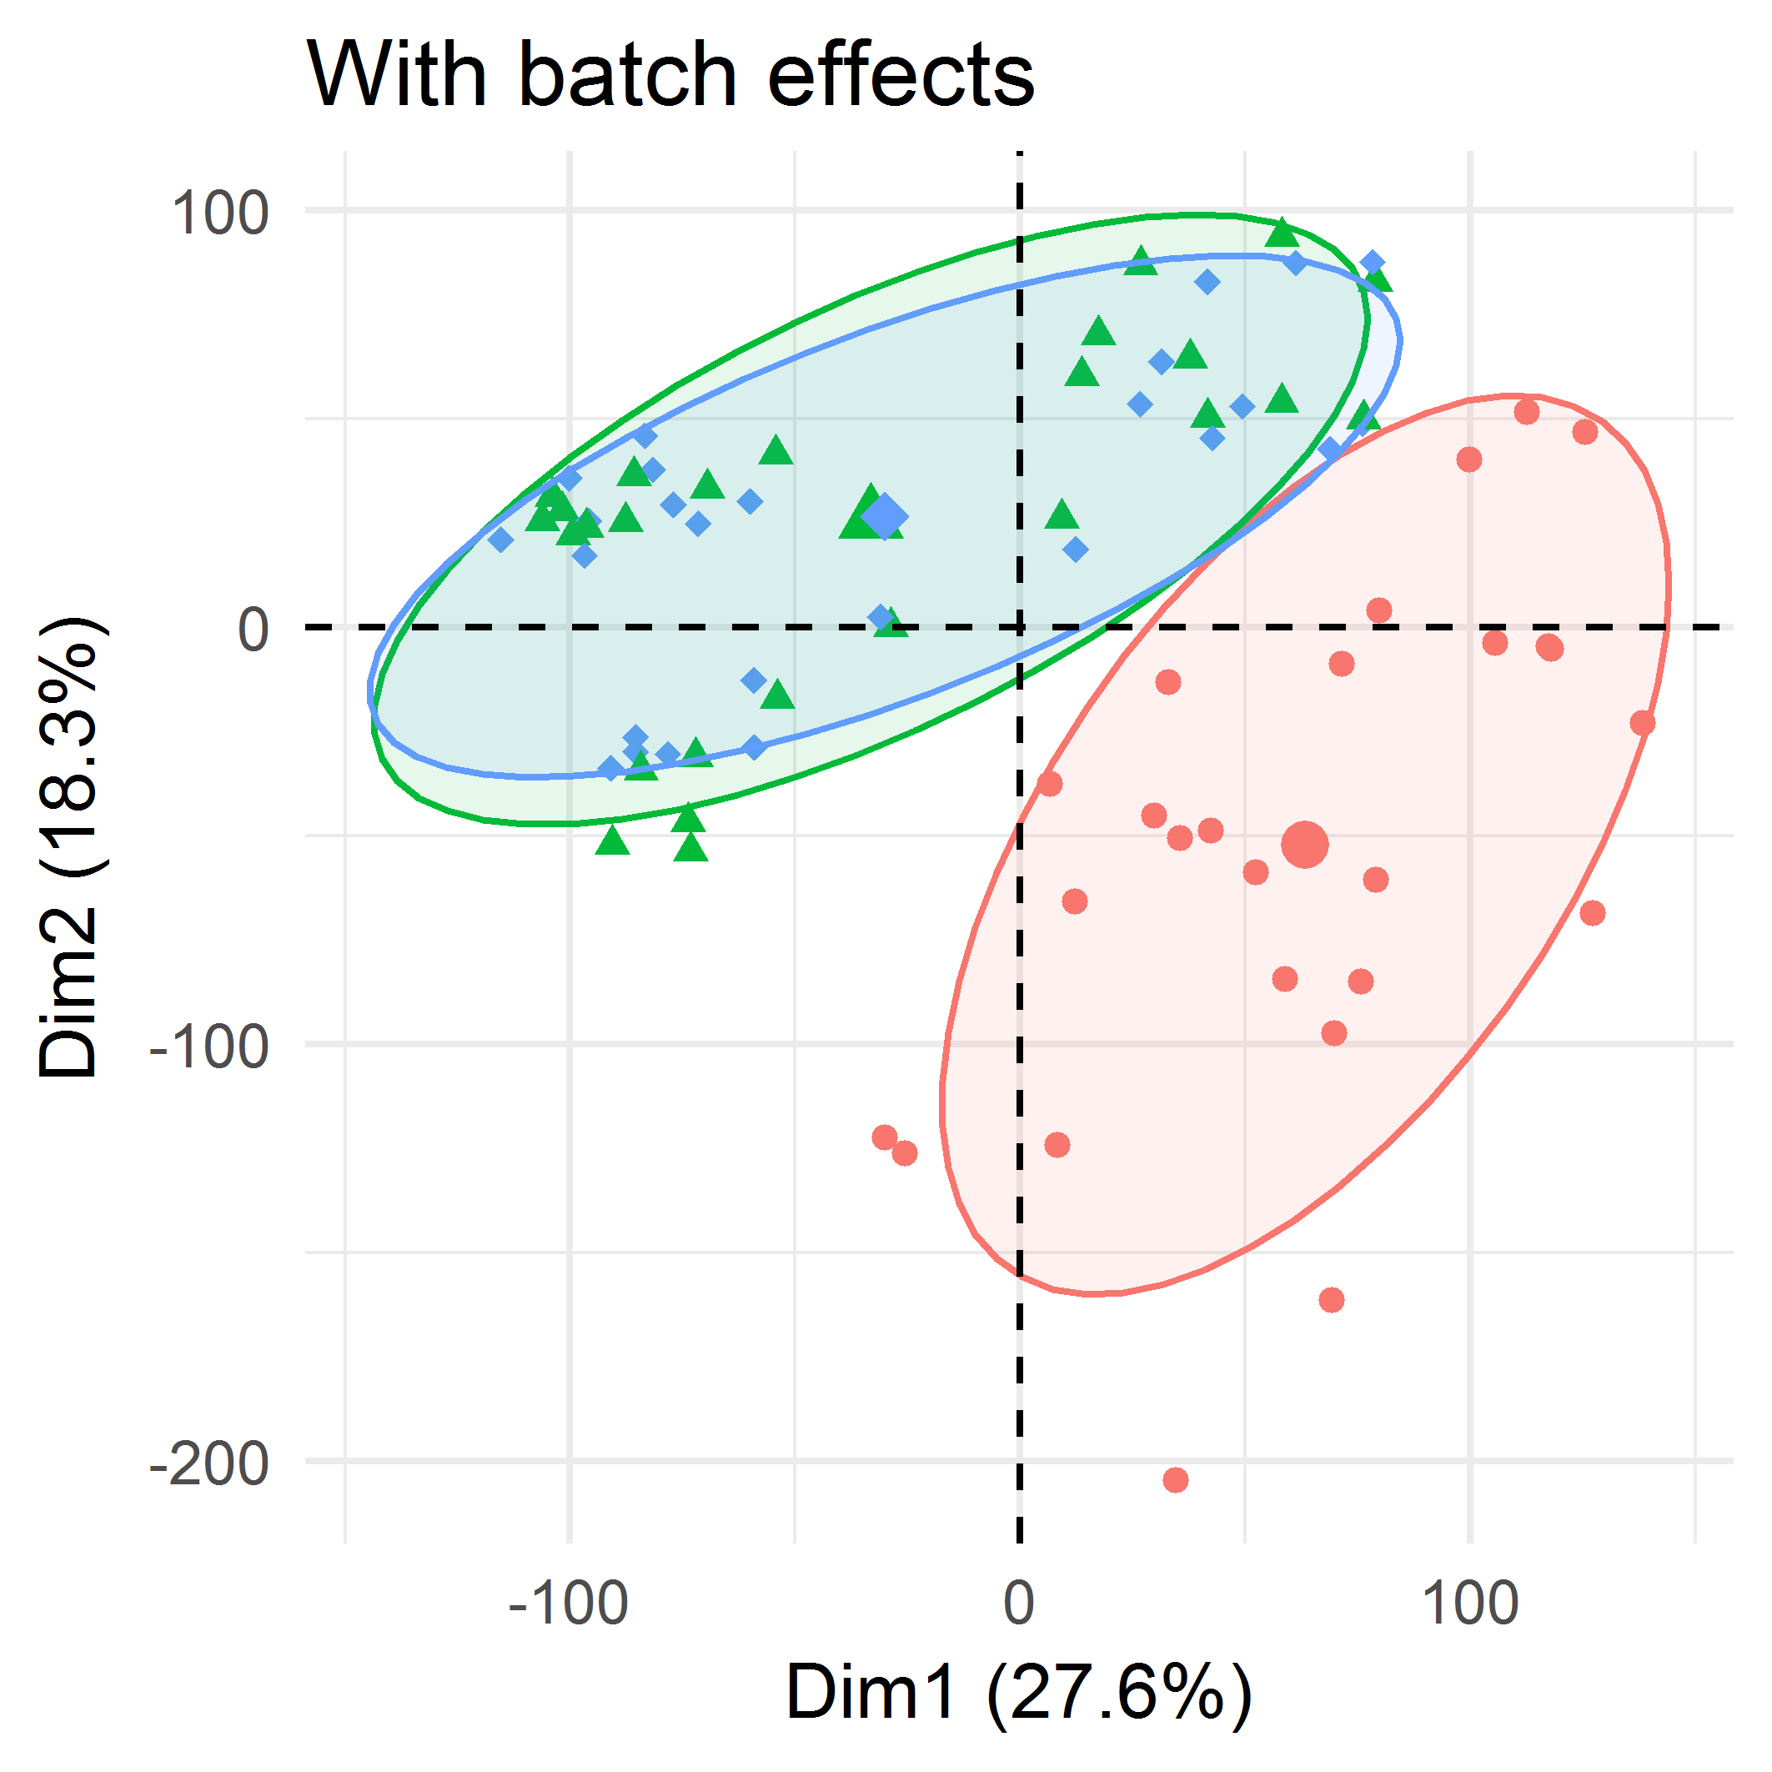
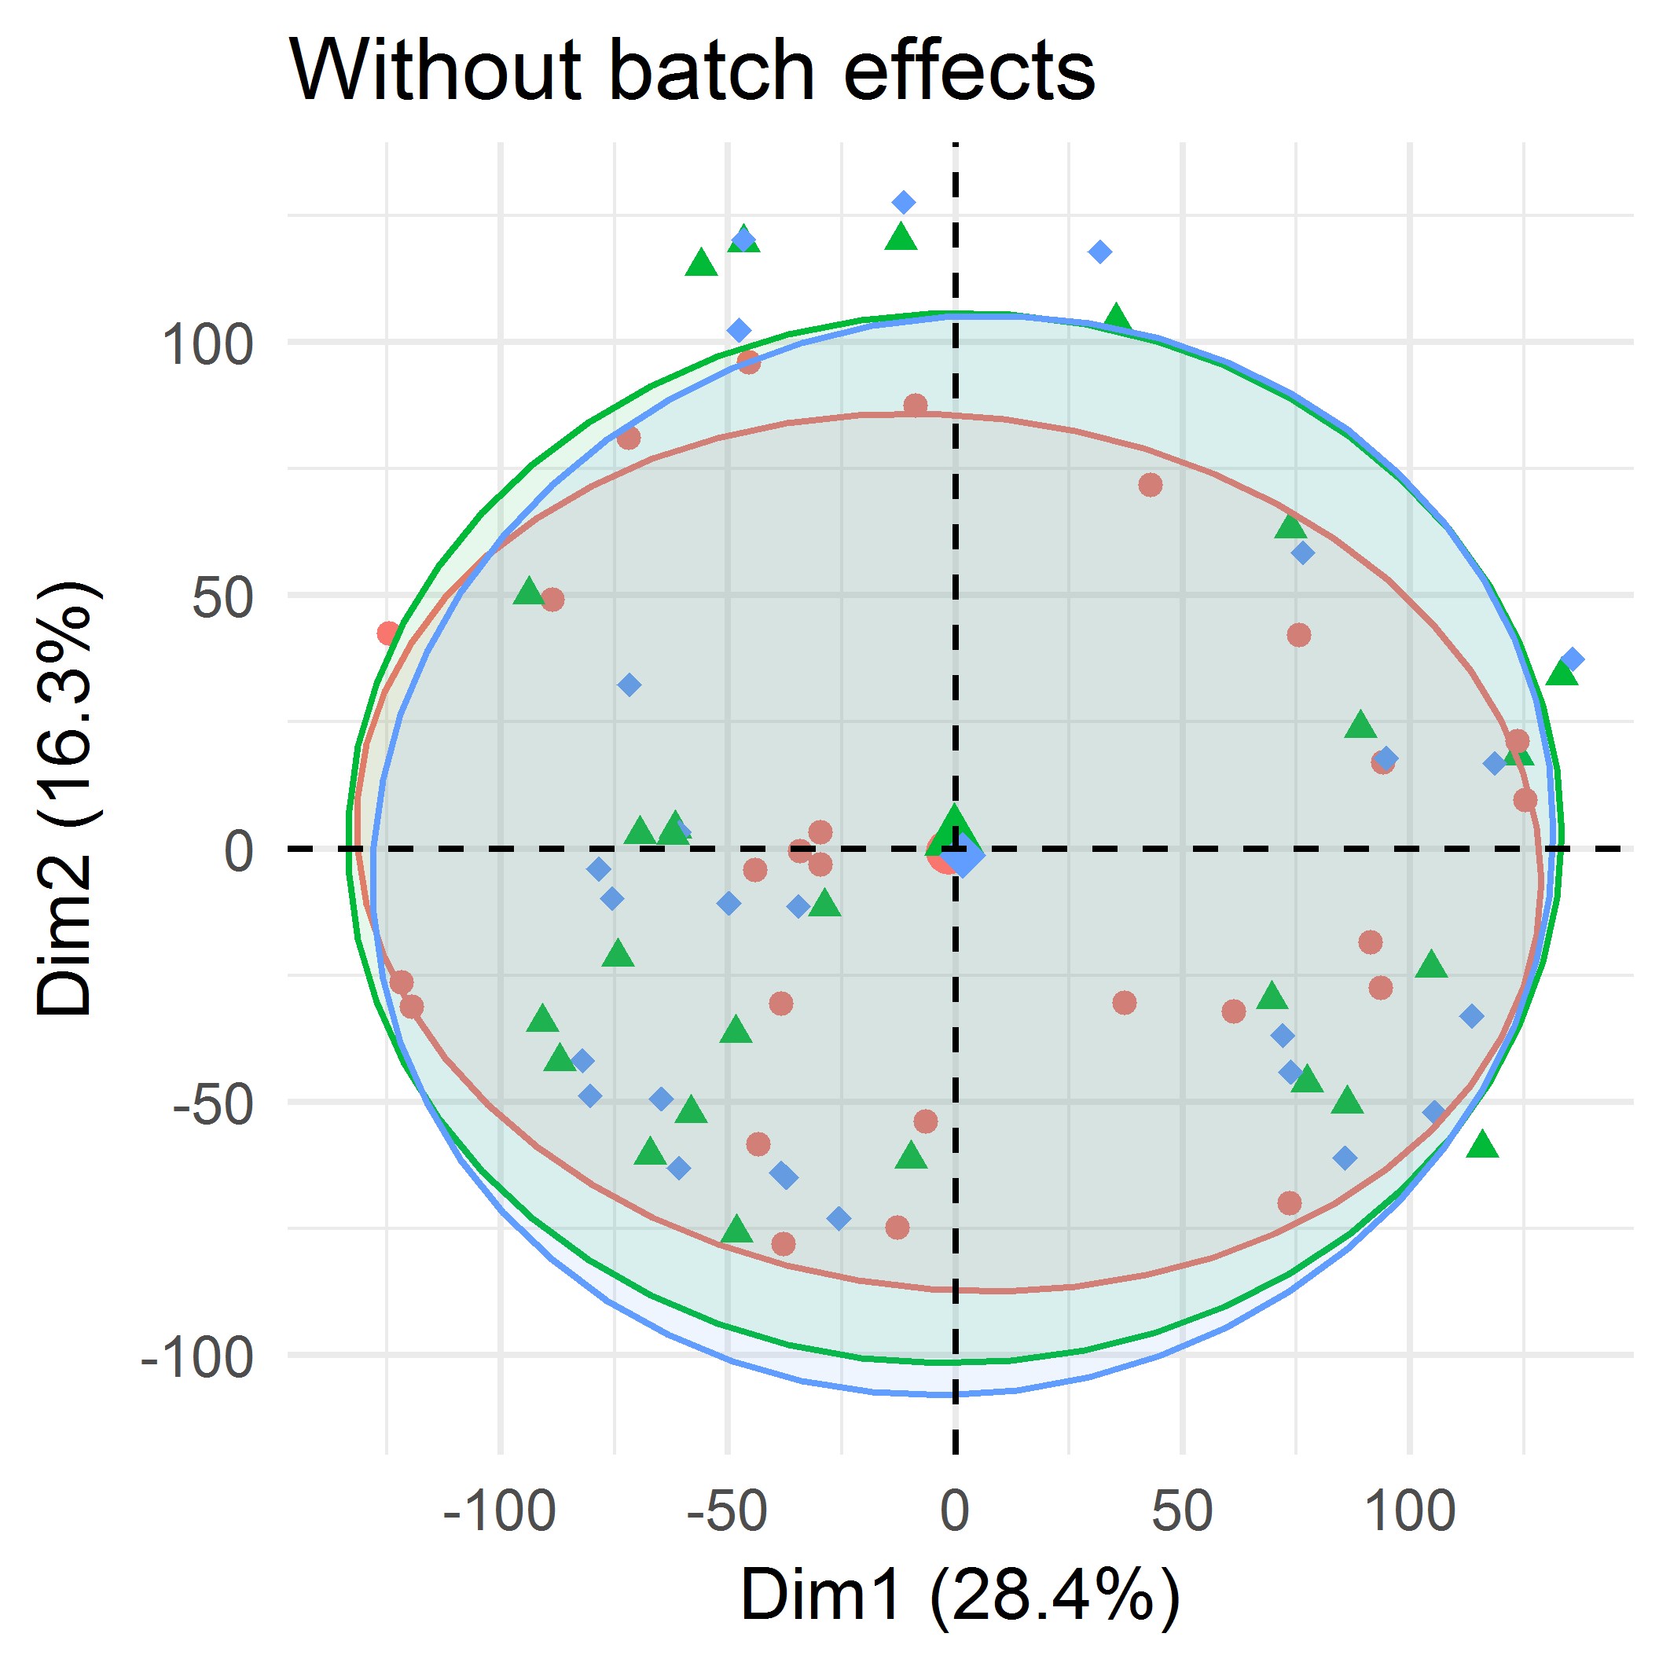
Cutting edge pre-processing pipeline for DE and DAS analysis
Remove low
expressed
transcripts/
genes
Estimate
batch effects
Data
normalisation
Generate
read counts
Transcript
quantification
Visualise
data quality
Identify and remove batch effects
DE/DAS analysis
pipeline
Salmon
Tximport R
package
Mean
variance
trend
RUVSeq R package
TMM
PCA plot/
FactoMineR R package

Slide 24
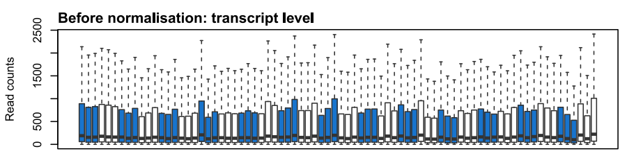
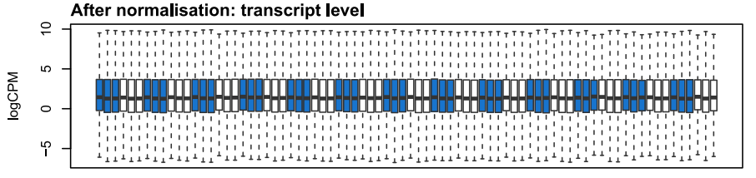
Cutting edge pre-processing pipeline for DE and DAS analysis
Remove low
expressed
transcripts/
genes
Estimate
batch effects
Data
normalisation
Generate
read counts
Transcript
quantification
Visualise
data quality
Normalization across samples
DE/DAS analysis
pipeline
Salmon
Tximport R
package
Mean
variance
trend
RUVSeq R package
TMM
PCA plot/
FactoMineR R package

Slide 25
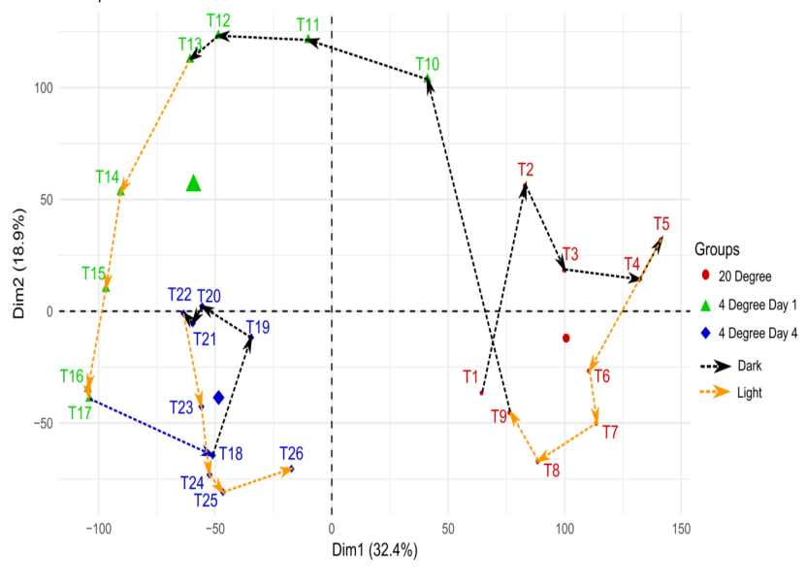
Cutting edge pre-processing pipeline for DE and DAS analysis
Remove low
expressed
transcripts/
genes
Data quality
Estimate
batch effects
Data
normalisation
Generate
read counts
Transcript
quantification
Visualise
data quality
DE/DAS analysis
pipeline
Salmon
Tximport R
package
Mean
variance
trend
RUVSeq R package
TMM
PCA plot/
FactoMineR R package

Slide 26
Cutting edge pipeline for Differential Expression (DE) and Differential Alternative Splicing (DAS) analysis
Mean variance trend
Linear model
Contrast groups
Gene level: DE genes
Transcriptional regulation
Transcript level: DAS genes
AS regulation
voom
limma
limma

Slide 27
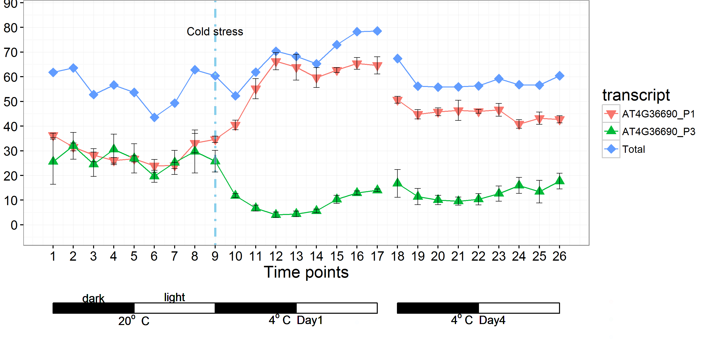
DAS analysis captures AS regulations missed by analysis at gene level
DAS gene analysis
Total (not DE)
CPM
Gene expression profiles: https://wyguo.shinyapps.io/atrtd2_profile_app/

Slide 28
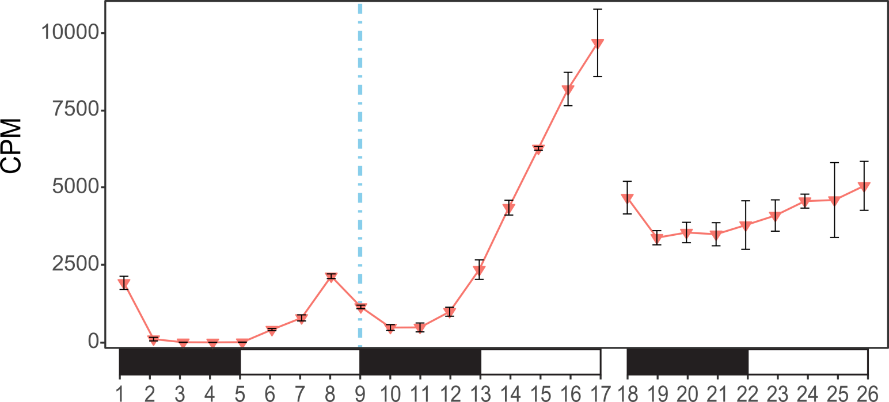
DE/DAS analysis pipeline allows flexible and complicated experimental design
DE gene analysis
17 contrast groups
Contrast group
20ºC
4ºC Day 1
4ºC Day 4
Notes:
Once the data get prepared, we use limma package to do the expression comparative analysis. To identify the DE genes, we set contrast group to compare the time-points in 4C to the same time-points in 20C. E.g. time 13 in cold is the same to time 5 in 20c. We calculate the l2fc of the abundance and statistically test if the difference is equal to 0. For every time points in 4c day 1 and day 4, we can define contrast groups like this. In total we have 17 contrast groups. The de genes are determined by adjusted p-value < 0.01 and log2 fold change >1 in at least two consecutive contrast groups.

Slide 29
DE/DAS analysis pipeline – good control of false discoveries
Applications:
Barley mutants (Bull et al., 2017).
Arabidopsis NMD mutants (Simpson, unpublished).
Potato mutants (E.Domingo-Torres, unpublished)
FDR assessment
20ºC
4ºC Day 1
4ºC Day 4
Zero DE genes or DAS genes detected between T1 and T9
Notes:
Once the data get prepared, we use limma package to do the expression comparative analysis. To identify the DE genes, we set contrast group to compare the time-points in 4C to the same time-points in 20C. E.g. time 13 in cold is the same to time 5 in 20c. We calculate the l2fc of the abundance and statistically test if the difference is equal to 0. For every time points in 4c day 1 and day 4, we can define contrast groups like this. In total we have 17 contrast groups. The de genes are determined by adjusted p-value < 0.01 and log2 fold change >1 in at least two consecutive contrast groups.

Slide 30
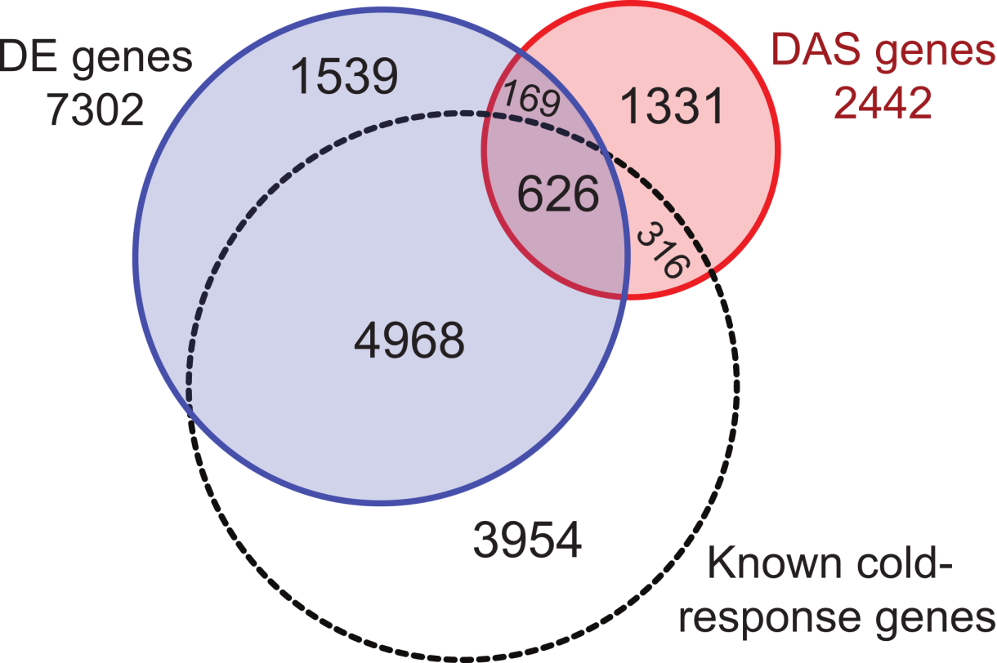
Novel cold-response genes and AS
3,039 novel cold-response genes – 1,331(42%) are DAS only
Novel cold response
genes (61.4% of DAS genes)
Novel cold response
genes (23.4% of DE genes)
9198 DE genes
RNA-seq
Gehan et al., 2015
Jia et al., 2016
Zhao et al, 2016
Microarray
Vogel et al., 2005
Carvallo et al., 2011
Leviatan et al., 2013
Notes:
We also compared our DE and DAS genes to the known cold response genes in current publication, we identified about 3k novel cold response genes. The known cold genes only have the information at transcriptional level. In our study, we also infer the DAS information of these genes.

Slide 31
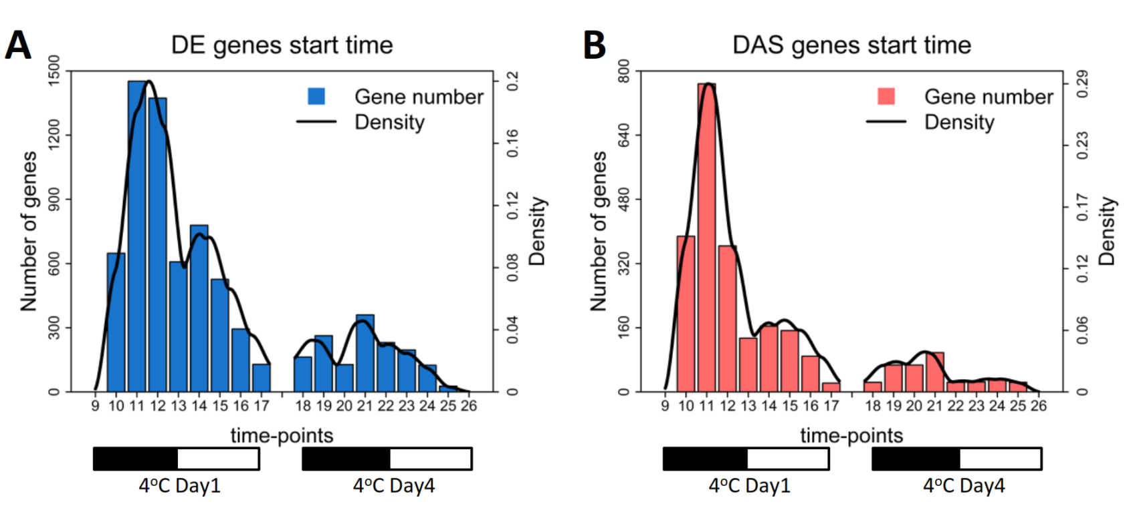
Dynamics of AS changes in response to cold
Time-points when DE and DAS first detected (non-cumulative)
0-9h (T10-T12):
47.6% (3,473) of DE genes
300 TFs
125 SFs
0-9h (T10-T12):
62.2% (1,520) of DAS genes
178 TFs
130 SFs
New insights in regulation by AS

Slide 32
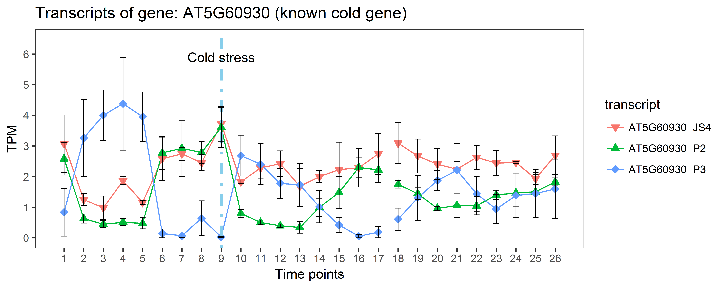
TSIS: An R package of time-series isoform switch analysis
Guo et al, TSIS: an R package to infer alternative splicing isoform switches for time-series data, Bioinformatics, 2017
20ºC
4ºC Day 1
4ºC Day 4

Slide 33
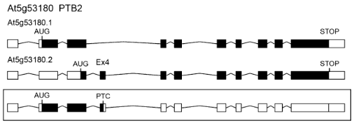
Transfix – “true” translations of
transcript isoforms
Longest reading frame
Authentic AUG
Identifies transcript isoforms:
coding for different protein variants
PTCs
Refined network construction
Protein sequence databases for proteomics

Slide 34
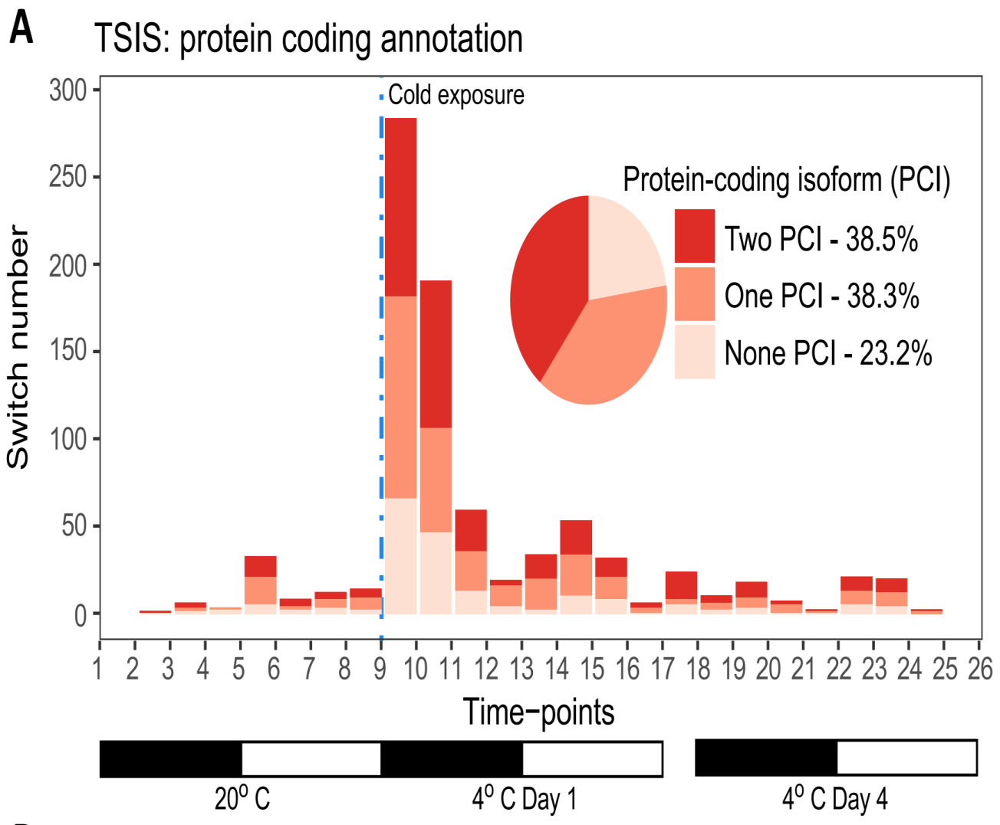

Rapid cold-responsive isoform switches
892 significant switches of transcripts in high abundance
(at least one time-point PS > 20% )
TSIS and Transfix
Transfer to 4ºC
76.8%
54% IS occurs within 0-6h after cold
Protein-coding annotation from AtRTD2 (Zhang et al., 2017)

Slide 35
Outline
Promises and challenges and of RNA-seq data
New resources, pipelines and methods for improved RNA-seq analysis
Summary

Slide 36

Computational pipelines enable large scale investigation of AS in HD
AtRTD2
Reference transcriptome /Salmon
3D RNA-seq
Transcriptional and AS regulations
TSIS
Transfix
Time-series isoform switch
Accurate translations
Zhang et al., NAR 2017;
Guo et al., 2017 Bioinformatics 2017
Rapid and dynamic alternative splicing impacts the Arabidopsis cold response transcriptome
Calixto et al. (2018)
Notes:
2 points:
1) These tools and pipelines now let us analyse RNA-seq data quickly and efficiently – we are waiting for data from a new time-course and expect to have it
analysed in 2 weeks – from raw data to DE/DAS, heatmaps etc
2) Apart from RTD2, tools are applicable to other species, to developmental series, multiple sample/screening (need to get how to say this correctly)

Slide 37
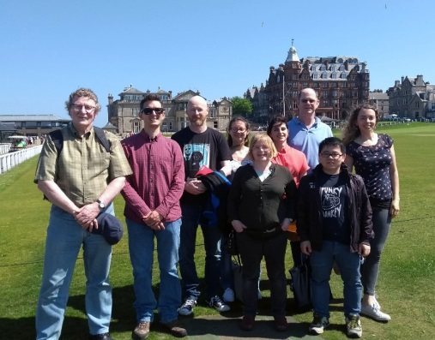




Acknowledgments
Plant Sciences:
Prof. John Brown
Dr. Wenbin Guo
Dr. Cristiane Calixto Dr. Nikoleta Tzioutziou
Juan Carlos Entizne
Prof. Hugh Nimmo
Dr. Allan James

Slide 38
Thank you!

Slide 39
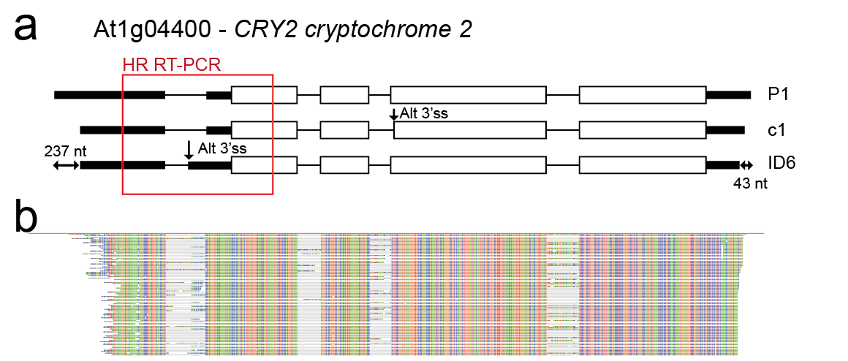
AtRTD2-QUASI overcomes effect of UTR variation
 | AS/FS ratio Alt 3’ss
HR RT-PCR | 0.028
Salmon-RTD2 | 0.295
Salmon-RTD2-QUASI | 0.024
Splice junction read counts | 0.018
Three-way corroboration:
Salmon/RTD2-QUASI
HR RT-PCR
Manual splice junction read counts
Notes:
This gives AtRTD2-QUASI (Quantification of Alternatively Spliced isoforms)
Here – thre transcripts differing in AS in the 5’UTR
Use Salmon/RTD2 and compare to HR RT-PCR and there is a tenfold difference in te splicing ratio of the alternative 3’ss transcript to fully spliced.
Use Salmon/AtRTD2-QUASI and ratio is virtually the same as Hr RT-PCR
Manually count splice junction reads for the alt 3’ss and it agrees also.

